Slide 1
Conditional Probability
the conditional probability P(x | y) = P(X=x | Y=y) is the probability of P(X=x) if Y=y is known to be true
  “conditional probability of x given y”

Slide 2
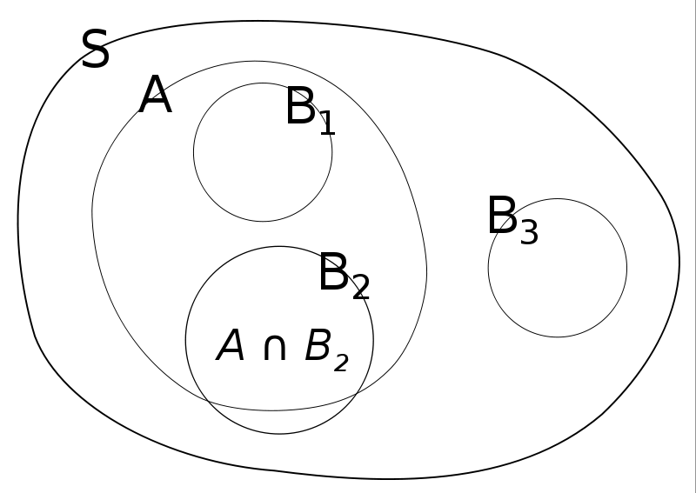
Conditional Probability

Slide 3
Conditional Probability
“information changes probabilities”
example:
  roll a fair die; what is the probability that the number is a 3?
  what is the probability that the number is a 3 if someone tells you that the number is odd? is even?
example:
  pick a playing card from a standard deck; what is the probability that it is the ace of hearts?
  what is the probability that it is the ace of hearts if someone tells you that it is an ace? that is a heart? that it is a king?

Slide 4
Conditional Probability
if X and Y are independent then

Slide 5
Bayes Formula
posterior

Slide 6
Bayes Rule with Background Knowledge

Slide 7
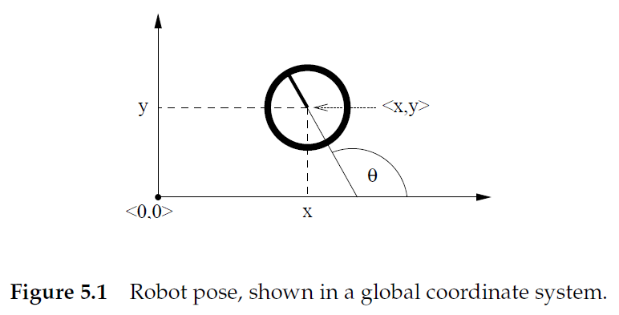
Back to Kinematics
location (in world frame)
pose vector or state
bearing or heading

Slide 8
Probabilistic Robotics
we seek the conditional density
what is the density of the state
given the motion command
performed at

Slide 9
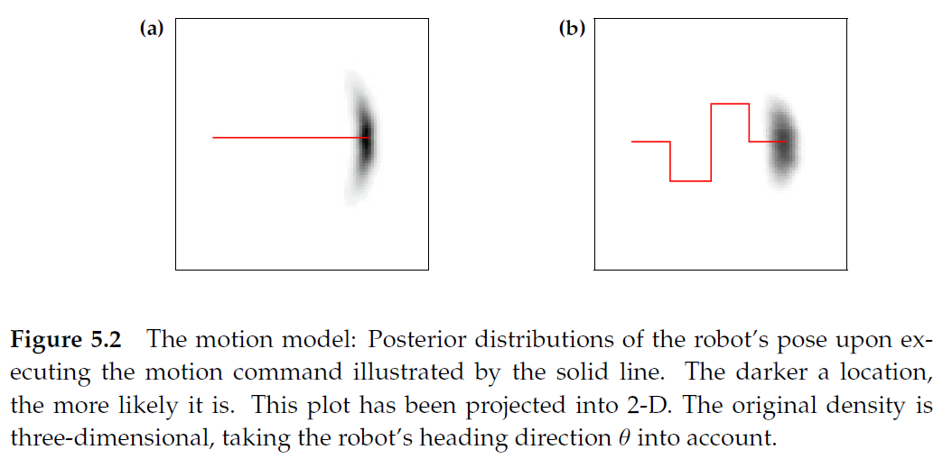
Probabilistic Robotics

Slide 10
Velocity Motion Model
assumes the robot can be controlled through two velocities
  translational velocity
  rotational velocity
our motion command, or control vector, is
positive values correspond to forward translation and counterclockwise rotation

Slide 11
Velocity Motion Model

Slide 12
Velocity Motion Model
center of circle
where

Slide 13
Velocity Motion Model

